Slide 1
Master of Science in Computer Science and Engineering
A Trusted and
Privacy-Enhanced
In-Memory Data Store
Jury:
Dr. João Moura Pires
Dr. Pedro Inácio
Adviser:
Dr. Henrique Domingos
Miguel de Lemos Dias Rosa Anciães
February 2021

Slide 2
Outline
Dissertation Elaboration
Introduction
Context and Motivation
Problem and Contributions
Proposed Solution
System Model and Architecture
Prototype
Experimental Evaluation
Conclusion and Future Work

Slide 3
Outline
Dissertation Elaboration
Introduction
Context and Motivation
Problem and Contributions
Proposed Solution
System Model and Architecture
Prototype
Experimental Evaluation
Conclusion and Future Work

Slide 4
Cloud Adoption
Context and Motivation
Data on the cloud is rising.
Processing and Storage needs more important than ever.
Rise of NoSQL databases.
24%
Rank | DBMS | Model
1. | Oracle | Relational
2. | MySQL | Relational
… | … | …
5. | MongoDB | Document
… | … | …
8. | Redis | Key-Value
76%
46%
54%
Gigabyte < Terabyte < Petabyte < Exabyte < Zettabyte
Notes:
Cada vez mais os dados das aplicações precisam de ser confidenciais e estão cada vez mais a ser NoSQL

Slide 5



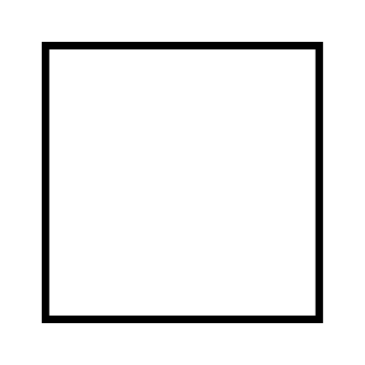

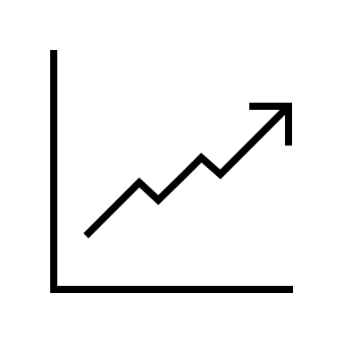
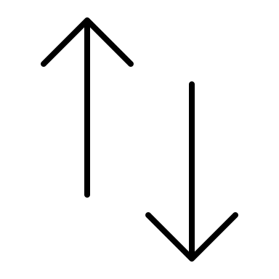






Why Cloud?
Context and Motivation
Cloud Benefits
Increased Productivity and Agility
Flexible Capacity / Scalability
Improved Availability and Bussiness Continuity
Reduced Costs / Pay as you Use

Slide 6



Why Cloud?
Context and Motivation
Cloud Security
Increased Productivity and Agility
Flexible Capacity / Scalability
Improved Availability and Bussiness Continuity
Reduced Costs / Pay as you Use
Notes:
No entanto, o aumento da facilidade e acessibilidade, podem abrir vetores de ataques adicionais.

Slide 7



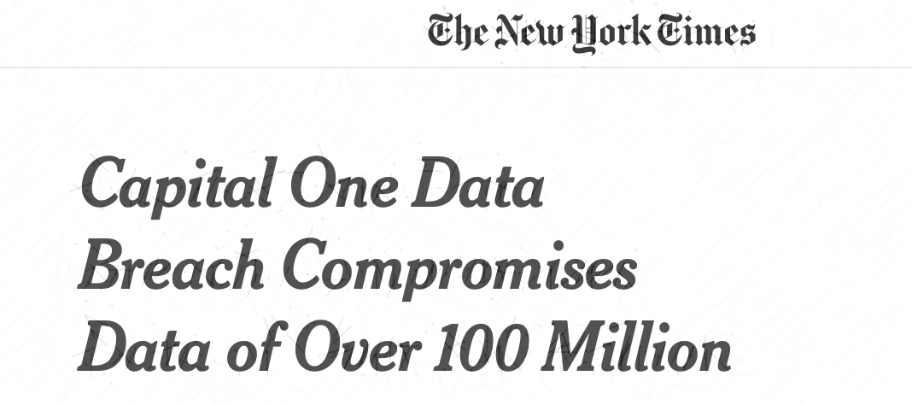
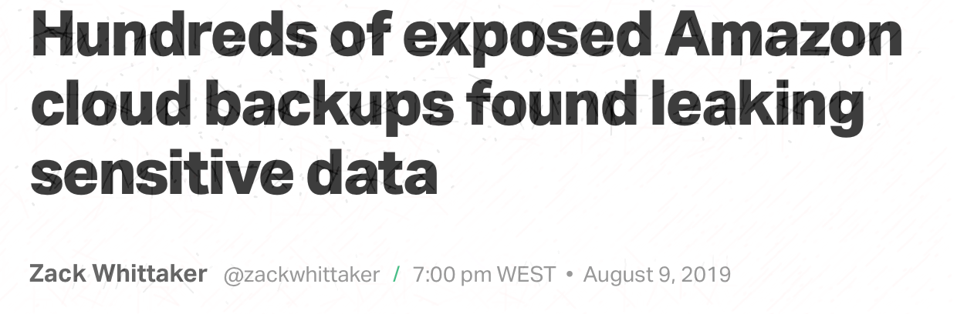
Relevant Incidents
Context and Motivation

Slide 8
Adoption Barriers
Context and Motivation
“More than 80% of all enterprises surveyed consistently respond that security and compliance are their top concerns in any cloud migration (…)”
---
Oracle - Moving Critical Applications to the Cloud

Slide 9
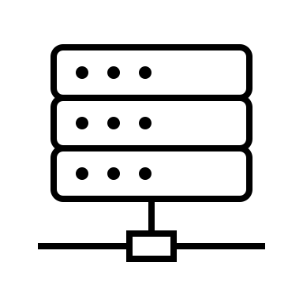
Problem / Threat Model
Problem and Contributions
Applications runs on a remote location, sharing several computing stack layers with other applications.
Also, it runs plain text data on unencrypted memory.
Opens several attack vectors:
Critical App
App
Shared Stack

Slide 10

Problem / Threat Model
Problem and Contributions
Critical App
App
Application runs plain text data on unencrypted memory and leads to:
Shared Stack
External Threats:
Memory Monitorization
Breaking confidentiality of data

Slide 11


Problem / Threat Model
Problem and Contributions
Critical App
App
Application runs plain text data on unencrypted memory and leads to:
Shared Stack
Internal Threats:
Malicious Administrator
Exploited Insiders
Memory Monitorization

Slide 12


Problem / Threat Model
Problem and Contributions
Critical App
App
Application runs plain text data on unencrypted memory and leads to:
Shared Stack
Isolation from malicious code:
Application on the same system
Code in OS or hypervisor
Buggy software
Notes:
Fracas condições de isolamento quando adversario atua nas layers mais fundas da pilha

Slide 13





Contributions
Problem and Contributions
Hardware
Hypervisor
OS
Drivers
Dependencies
Cloud-enabled Privacy-Enhanced Solution
Secure Data In-Memory
Confidentiality of App (KVS)
Attestation
TCB Reduction
Hardware backed isolation
Analysis Report
Throughput
Latency
Resources
Notes:
8º minute
Design and implementation of the cloud-enabled privacy-enhanced solution
Trust-ability, security and privacy
Software attestation
Solution oriented for in memory KVS platforms
Preserving native/built-in operations
TCB Reduction and Isolation
Hardware backed TCB and isolated processing
Analysis Report
Standard Solution vs. Privacy Enhanced Solution
Throughput, latency
Memory and CPU (resources)

Slide 14
Outline
Dissertation Elaboration
Introduction
Context and Motivation
Problem and Contributions
Proposed Solution
System Model and Architecture
Prototype
Experimental Evaluation
Conclusion and Future Work

Slide 15


Proposed Solution
Proposed Solution
Introduce a Trusted Execution Environment enabling processor.
A TEE provides code execution isolation.
Provides attestation services.
A TEE virtualization/abstraction library helps with integration and to overcome limitations.
Application
Library
TEE
Notes:
Explain attestation service. Explain better TEE. Codigo carregado para ser executado dentro de uma memori aprotegiada que é geriada dentro do proprio processador.
Attestatação dá garantias que o codigo injectado é o correcto
Virtualization dá transparencia para a aplicação

Slide 16
General Architecture
Proposed Solution
Application
Containerization Tecnhology
Host OS
Hypervisor
Hardware
Notes:
TODO: Change colors

Slide 17
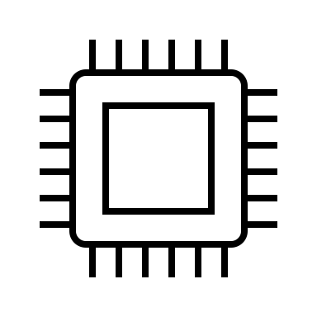
General Architecture
Proposed Solution
Application
Attestation Service
Application
TEE Abstraction Layer
Containerization Tecnhology
Containerization Tecnhology
Host OS
Host OS
Hypervisor
Hypervisor
Hardware
Hardware
TEE
Notes:
TODO: Change colors

Slide 18




System Model Overview
Proposed Solution
Key Value Store
Local Attestation Service
Proxy
Key Value Store
Auth Server

Slide 19
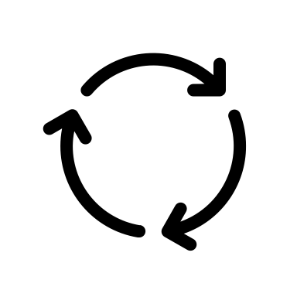


Proxy
Proposed Solution
Proxy
Auth
Encryption Service
Secure Storage Server
Unsecure Storage Server
Attestation Server

Slide 20
Key-Value Store
Proposed Solution
Secure Storage Server
Unsecure Storage Server
Limitations:
Memory
Performance
Attestation Server
< hello, world >
< foo, bar >
< plain, text >
< /kmX9I0YxspdsATlydGePA==, gJBeJwT/iIR8GCszlLfTXg== > < Dvy1r4XamuOXpTWFa6g+Fg==, 7QkxWv3C/LrYu8Ql1dgLkQ== > < /MIqISpkZS5+bHkyFys5tQ==, uCzWdvDomApnRVSMvkUVuw== >

Slide 21

Key-Value Store
Proposed Solution
Secure Storage Server
Unsecure Storage Server
Limitations:
Memory
Performance
Attestation Server
< hello, world >
< foo, bar >
< plain, text >
< /kmX9I0YxspdsATlydGePA==, gJBeJwT/iIR8GCszlLfTXg== > < Dvy1r4XamuOXpTWFa6g+Fg==, 7QkxWv3C/LrYu8Ql1dgLkQ== > < /MIqISpkZS5+bHkyFys5tQ==, uCzWdvDomApnRVSMvkUVuw== >

Slide 22
Key-Value Store
Proposed Solution
Secure Storage Server
Unsecure Storage Server
Limitations:
Memory
Performance
Attestation Server
< hello, world >
< foo, bar >
< plain, text >
< /kmX9I0YxspdsATlydGePA==, gJBeJwT/iIR8GCszlLfTXg== > < Dvy1r4XamuOXpTWFa6g+Fg==, 7QkxWv3C/LrYu8Ql1dgLkQ== > < /MIqISpkZS5+bHkyFys5tQ==, uCzWdvDomApnRVSMvkUVuw== >

Slide 23


Attestation Flow
Proposed Solution
Key Value Store
Mechanism to check system’s state
External CAS holds application secrets/configs
Application fetches signed quote from LAS
CAS recives quote and verifies it.
If correct returns secrets
Local Attestation Service
Configuration and Attestation Server
Notes:
Implicit attestation flow performed by the SCONE framework at application startup.
Secrets returned are stored inside the enclave in protected memory and destroyed when enclave terminates
If attestation fails, application will not start

Slide 24
Prototype Technologies
Prototype Implementation
Application
Attestation Service
TEE Abstraction Layer
Containerization Tecnhology
Host OS
Hypervisor
Hardware
TEE

Slide 25
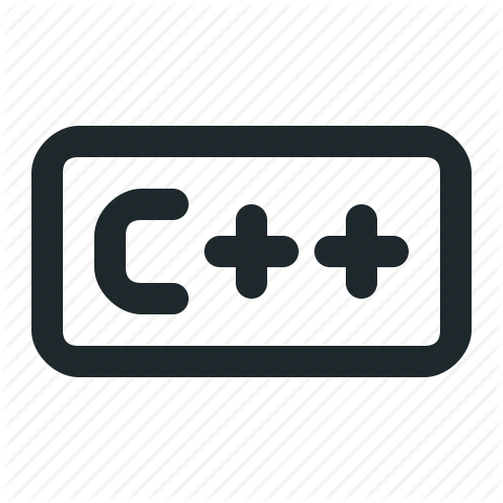

Key Value Store
Prototype Implementation
Attestation Service
uyviuvb
Hypervisor
Hardware
TEE

Slide 26


Proxy
Prototype Implementation
Attestation Service
Hypervisor
Hardware
TEE

Slide 27




Other Components
Prototype Implementation
Authentication Server
Benchmark Client
Open source Identity and Access Management Service.
Implements standard SSO directives
Notes:
Implements standard SSO directives and uses JWT’s to establish user identity, roles and permissions.

Slide 28
Prototype Location
Proposed Solution
Repository https://github.com/ | Docker Hub hub.docker.com/repository/docker | Latest Version
aanciaes/secure-redis-container | aanciaes/secure-redis | v1.1.5
aanciaes/secure-redis-proxy | aanciaes/secure-redis-proxy | v1.3.1
aanciaes/secure-redis-client | - | v1.0.0
TODO: Is this slide necessary?? Does not seam right, but it was in the professor’s notes

Slide 29
Outline
Dissertation Elaboration
Introduction
Context and Motivation
Problem and Contributions
Proposed Solution
System Model and Architecture
Prototype
Experimental Evaluation
Conclusion and Future Work

Slide 30
Tests & Environment
Experimental Evaluation
Redis in two modes:
Standalone
Cluster
Performance
Latency
(ms)
Throughput
(ops/s)
Resources
Memory Consumption
(MB)
CPU Load
(%)
Homomorphic Encryption:
Plain Text
Standart Encryption
Homomorphic Encryption
As many requests as possible in 10 minutes

Slide 31

Tests & Environment
Experimental Evaluation
Client (Commodity Hardware)
Proxy
Secure Proxy
Secure Proxy
Redis
Encrypted Redis
Secure Redis

Slide 32
Standalone Redis
Experimental Evaluation
Configuration | # Ops | RTT | Avg Loss
Proxy & Redis | 14038 | 42ms | -
Proxy SGX & Redis Encrypted | 12773 | 48ms | 20%
Proxy SGX & Redis SGX | 12013 | 50ms | 22%

Slide 33
Clustered Redis
Experimental Evaluation
Configuration | # Ops | RTT | Avg Loss
Proxy & Redis | 14038 | 41ms | -
Proxy SGX & Redis Encrypted | 12773 | 46ms | 20%
Proxy SGX & Redis SGX | 12013 | 49ms | 22%

Slide 34
Resources
Experimental Evaluation

Slide 35
Homomorphic Encryption
Experimental Evaluation
Proxy SGX & Plain Redis
Proxy SGX & Homo Encrypted Redis
Proxy SGX & Encrypted Redis

Slide 36
Outline
Dissertation Elaboration
Introduction
Context and Motivation
Problem and Contributions
Proposed Solution
System Model and Architecture
Prototype
Experimental Evaluation
Conclusion and Future Work

Slide 37
Conclusion
Final Notes
Hardware
Hypervisor
OS
Drivers
Dependencies
We were able to implement a Cloud-enabled Privacy-Enhanced Solution:
KVS-as-a-Service
Privacy and Integrity Preservation
Reduced Trusted Computing Base
About 20% trade-off (bearable depending on the use case)

Slide 38
Future Work
Final Notes
SGX
SGX v2
On-demand Remote Attestation
Proxy
Replication
Multi-User/Tenant Support
Virtualization
Test other frameworks
Redis
Secure Disk Persistence
Notes:
SGXv2 – dynamic memory allocation
On-demand SGX enabled attestation
On disk secure Persistence
Proxy Replication
Proxy Multi-Tenant support
Testing other SGX virtualization platforms other than SCONE

Slide 39
A Trusted and
Privacy-Enhanced
In-Memory Data Store
February 2021

Slide 41
Slide Design Idea

Slide 42
Dissertation Storyline
Dissertation Elaboration
There is a trend to move to cloud. A lot of data and processing is moving to the cloud, and cloud providers are working to adapt their services to allow for faster processing and secure data storage.
But why are people moving to the cloud? Reduced costs, scalability on demand, improved availability and increase productivity and agility. However with all that data in the cloud, there haven been more attacks than ever. Which leads to the biggest cloud adoption barrier becoming security.
With the cloud becoming a shared infrastructes it opens up direct, undirect memory attacks.
To prevent these attacks, we will test an application that makes use of a TEE to isolate the application from everything. Use of a TEE virtualization framework to help with performance and integration.

Slide 43
Dissertation Storyline
Dissertation Elaboration
So, we protect the normal stack by adding a TEE into the hardware. We make use of a tee virtualization framework to aid with integration and deployment. Also add an attestation service to make sure everything is correct during the runtime.
We use the presented stack to implement the compoments in the system model presented below. This system model has four main components, the proxy, the KVS, the authentication server, the attestation servers and the client.
If we focus on the KVS, we can see two main configurations. The secure and nonsecure config. The secure works with the TEE and maintains the data in memory in plain text. To attack the memory limitations of the TEE, we maintain a larger dataset out of secure memory, (normal RAM) and maintain confidentiality by keeping all data actively encrypted. We also attck the performance issues by using an homomorphic encryption algorithm to perform operations over encrtyped data.

Slide 44
Outline
Dissertation Elaboration
Introduction
Context and Motivation
Problem and Contributions
Proposed Solution
System Model and Architecture
Prototype
Experimental Evaluation
Conclusion and Future Work

Slide 45
Adoption Barriers
Context and Motivation
TODO: Maybe this slide is not needed
Critical with large datasets with sensitive data
Critical applications
Add 2/3 better references
Thus, the top concerns among enterprises have been remarkably consistent over years of asking the question: What’s the major obstacle to cloud migration?
 Security/Compliance  Migration/Integration/Skill Sets
 Cost
More than 80% of all enterprises surveyed consistently respond that security and compliance are their top concerns in any cloud migration or transformation effort, followed by concerns over exactly how to effect a migration and how to identify and acquire new skills and resources.

Slide 46
Dissertation Problem
Problem and Contributions
Problem
Adversary Model
Honest but Curious model, negligent employee, exploited employee, malicious insiders
Insider Threats
Attacker capable of compromising the system through another application installed on the same system or malicious code existent or injected in the OS or OS hypervisor layers
Large trusted Computing Base
Performance vs Security
Secure Memory and Encrypted File System

Slide 47
Problem / Threat Model
Problem and Contributions
Direct attacks
Undirect attacks
Internal:
Physical Access
Memory Monitorization
by Exploited/Balckmailed Func.
Breaking confidentiality
External:
Communication
Data in transit
Exploited/Buggy external software
Beeing OS, hypervisor or even other apps
Installed on the same physical machine

Slide 48



Problem / Threat Model
Problem and Contributions
App
App
Shared Stack
Data in Transit:
External
Internal

Slide 49
Dissertation Contributions
Problem and Contributions
Design and implementation of the cloud-enabled privacy-enhanced solution
Trust-ability, security and privacy
TCB Reduction and Isolation
Hardware backed TCB and isolated processing
Software attestation
Solution oriented for in memory KVS platforms
Preserving native/built-in operations
Analysis Report
Standard Solution vs. Privacy Enhanced Solution
Throughput, latency
Memory and CPU (resources)

Slide 50
Standalone Redis
Experimental Evaluation
Configuration | # Ops | RTT | DB Size
Proxy & Redis | 14038 | 42ms | 2 MB
Proxy SGX & Redis SGX | 12013 | 50ms | 2 MB
Proxy SGX & Redis Encrypted | 12773 | 48ms | 6,5 MB

Slide 51
Resources
Experimental Evaluation
Add simplistic memory graphs

Slide 52
Resources
Experimental Evaluation

Slide 53
Conclusion
Final Notes
Referencing the SGX secure enclaves, we saw a performance drop of about 18% to approximately 25%, because the performance of an application running on an enclave depends on these three main points:
Memory Access Local: If the application exceeds the EPC size limit, memory is swapped to main memory and that requires additional encryption and decryption cycles.
System Calls: System calls require enclave exiting and entering which is a slow pro- cess. However, SCONE uses an asynchronous system call interface that ensures that threads do not need to exit the enclave to perform a system call.
Threading: SCONE uses asynchronous application threading in order to allow switching to another application thread if another one is waiting for some system event, without exiting the enclave, which can speed up the performance.
We were able to provide a solution with beareble trade-offs (depending on the use case)
Trust-ability, security and privacy.
Software attestation
Replication Mechanism
Drastically reduced TCB
Complete analysis report.

Slide 54
References
Final Notes
Cloud Adoption: https://dzone.com/articles/cloud-data-centers-are-poised-to-take-the-spotlight, https://db-engines.com/en/ranking
Why Cloud? - https://www.isc2.org/-/media/ISC2/Landing-Pages/2019-Cloud-Security-Report-ISC2.ashx?la=en&hash=06133FF277FCCFF720FC8B96DF505CA66A7CE565
Adoption Barriers - http://www.oracle.com/us/solutions/cloud/move-critical-apps-to-cloud-4441209.pdf
Relevant Incidents - https://healthitsecurity.com/news/remote-attacks-on-cloud-service-targets-rose-630-amid-covid-19

